Slide 1
Machine Learning MCA 5152

Slide 2
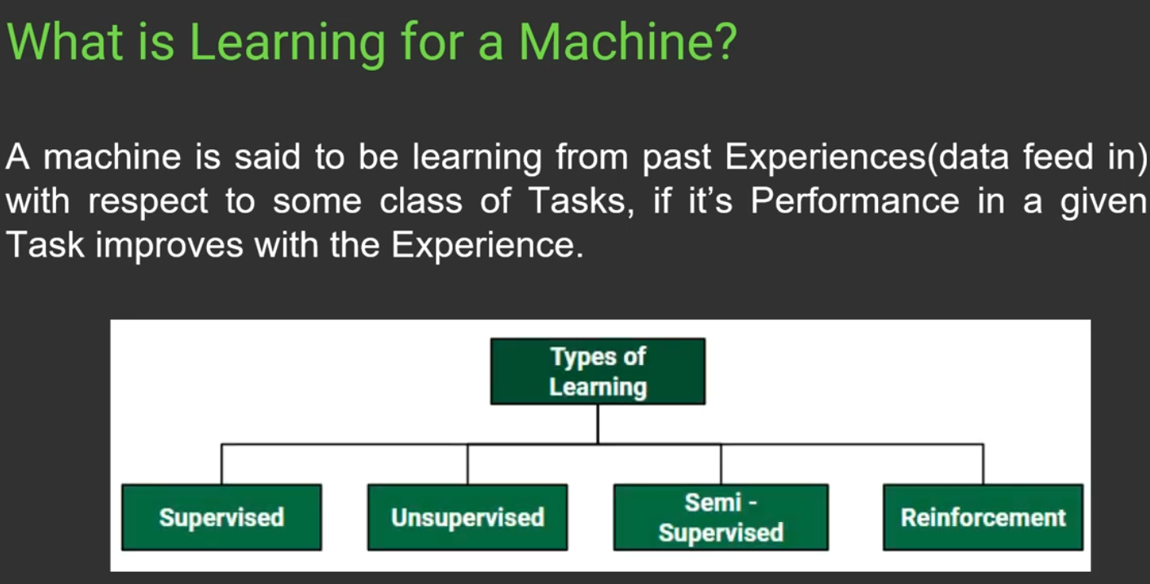

Slide 3
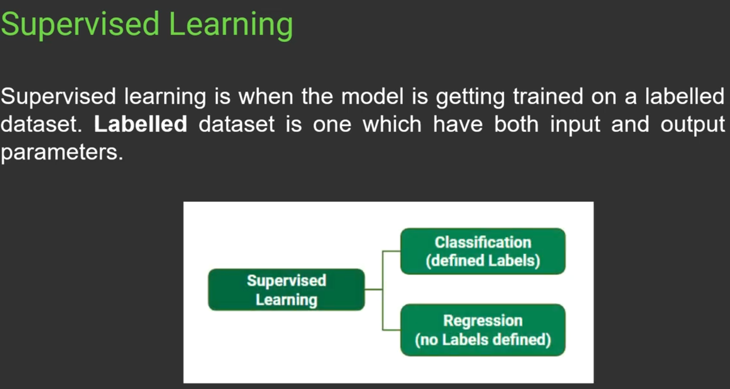

Slide 4
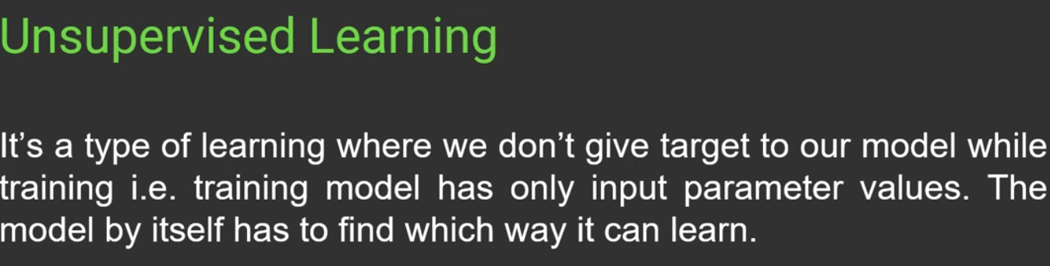

Slide 5
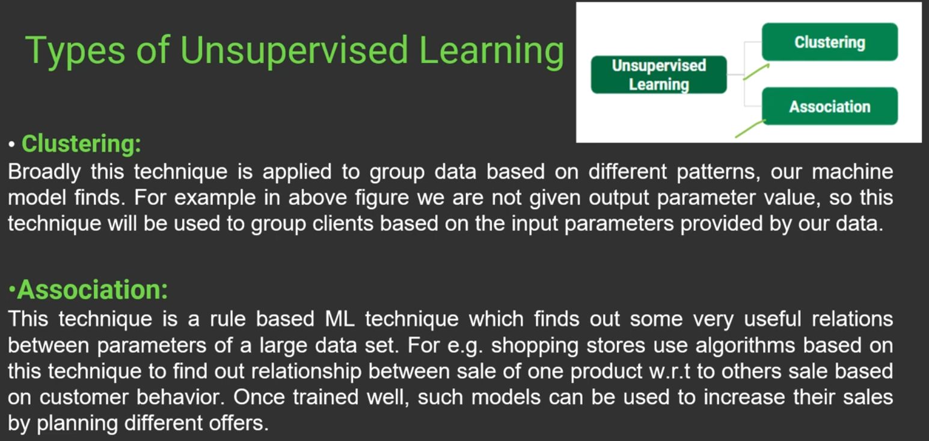

Slide 6
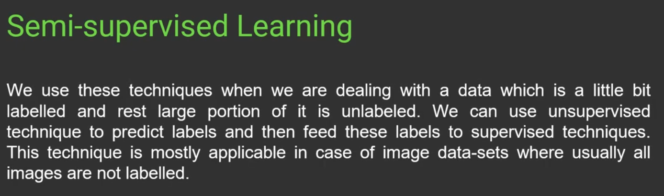

Slide 7
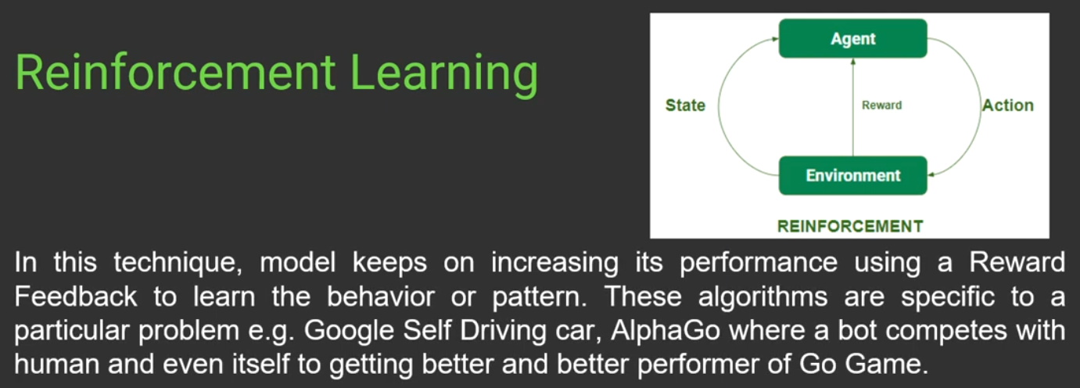

Slide 8
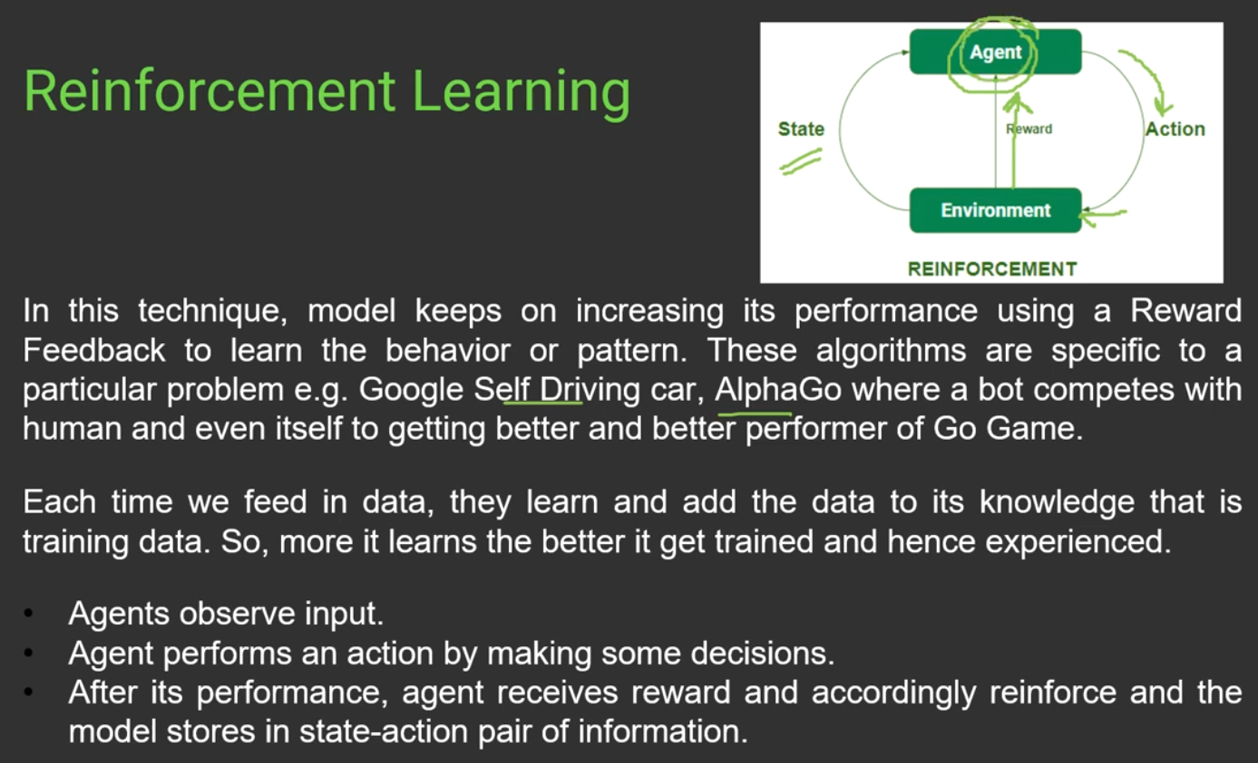

Slide 9
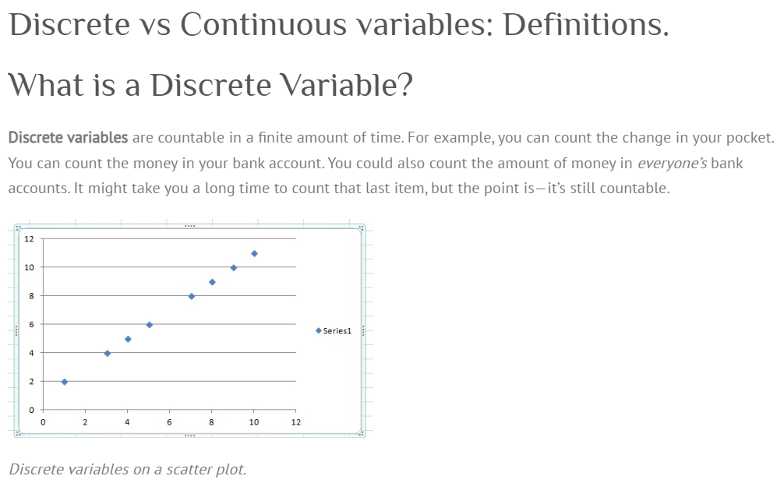

Slide 10
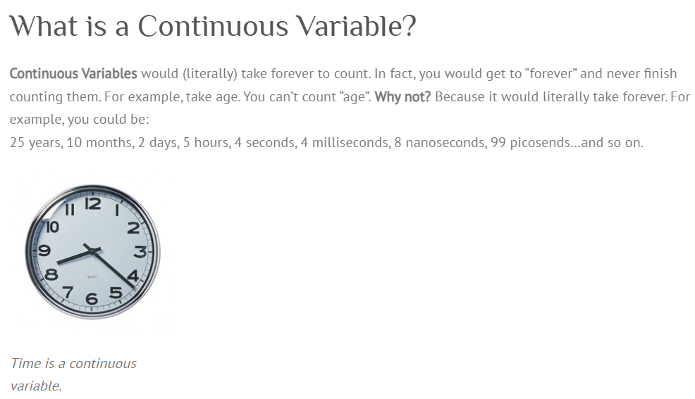

Slide 11
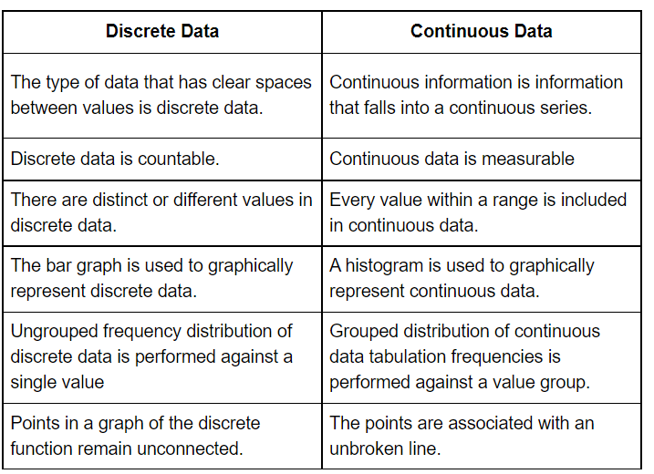

Slide 12
Contents
History
Definition of ML
Types of Learning
Supervised Learning
Unsupervised Learning
Reinforcement Learning
Terminology
Hypothesis Space
Inductive Bias
Inductive Learning
Generalization
Bias & Variance
Basic Concepts in Machine Learning
Parametric vs. Non Parametric Models
Curse of Dimensionality
Model Selection
No free lunch theories

Slide 13
History
1950s – Arthur Samuel’s checkers playing games
1960s
Rosenblatt proposed a perceptron
Delta Learning Rule
Minsky and Papert
1970s
Symbolic concept of Induction
Expert systems
Ross Quinlan’s ID3
Symbolic Natural Language Processing
Notes:
Machine which is as capable as humans. Artificial Intelligence .
The main driver of the machine was a search tree of the board positions reachable from the current state. Since he had only a very limited amount of available computer memory, Samuel implemented what is now called alpha-beta pruning
Rosenblatt – perceptron illustrates fundamental properties of intelligent systems, without becoming enmeshed in special and frequently unknown conditions. an electronic device which was constructed with biological principles and showed an ability to learn. initially simulated on an IBM 704 computer at Cornell Aeronautical Laboratory in 1957.^{[7]} When a triangle was held before the perceptron's eye, it would pick up the image and convey it along a random succession of lines to the response units, where the image was registered
Delta learning rule or least square problem- the delta rule is a gradient descent learning rule for updating the weights of the inputs to artificial neurons in a single-layer neural network.
Induction where a system tries to induce a general rule from a set of observed instances.
Minsky – limitations of perceptron, said the perceptron cannot handle XOR problem , inseperable data distributions cannot be handled.
Symbolic AI uses human-readable symbols that represent real-world entities or concepts as well as logic (the mathematically provable logical methods) in order to create ‘rules’ for the concrete manipulation of those symbols, leading to a rule-based system.

Slide 14
History
1980s
Advanced Decision Trees and Rule Learning
Resurgence in Neural Networks – Back Propagation
Werbos - Multilayer Perceptron Networks
Valiant’s Probably Approximate Correct Learning (PAC) Learning Theory – experimental methodology
1990s
Vapnik, Cortes – Support Vector Machines, Kernels in 2000
Data Mining
Freund & Shapire – ADA Boost – create a strong classifier from an ensemble of weak classifiers
Bremen - Random Forest - 2001
Bayes Net
Adaptive Agents and Web Applications
Notes:
Williams and Neilson worked on Back Propogation.
Valiant’s
SVM had empirical results.

Slide 15
History
2000s
Deep Learning
New Hardware – GPUS
Cloud Enabled
Availability of Big Data
Milestones
1997 – Deep Blue beat Gary Kasparov in a game of chess
2009 – Google built Self Driving Cars
2011 – IBM’s Watson won the popular game of jeopardy
2014 – Human Vision surpassed by ML vision

Slide 16
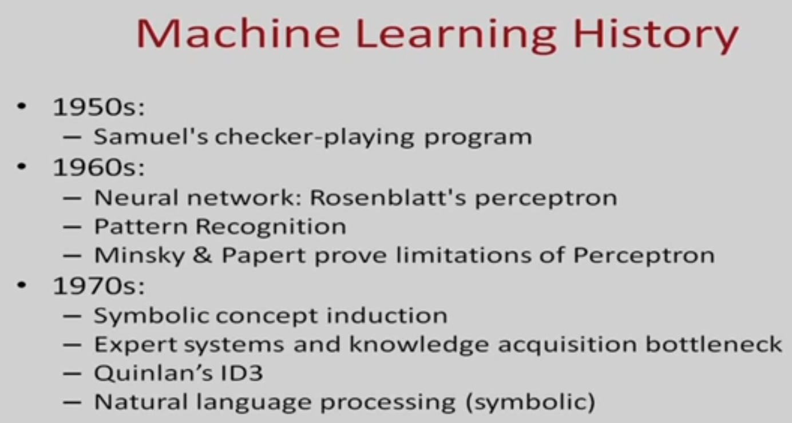

Slide 17
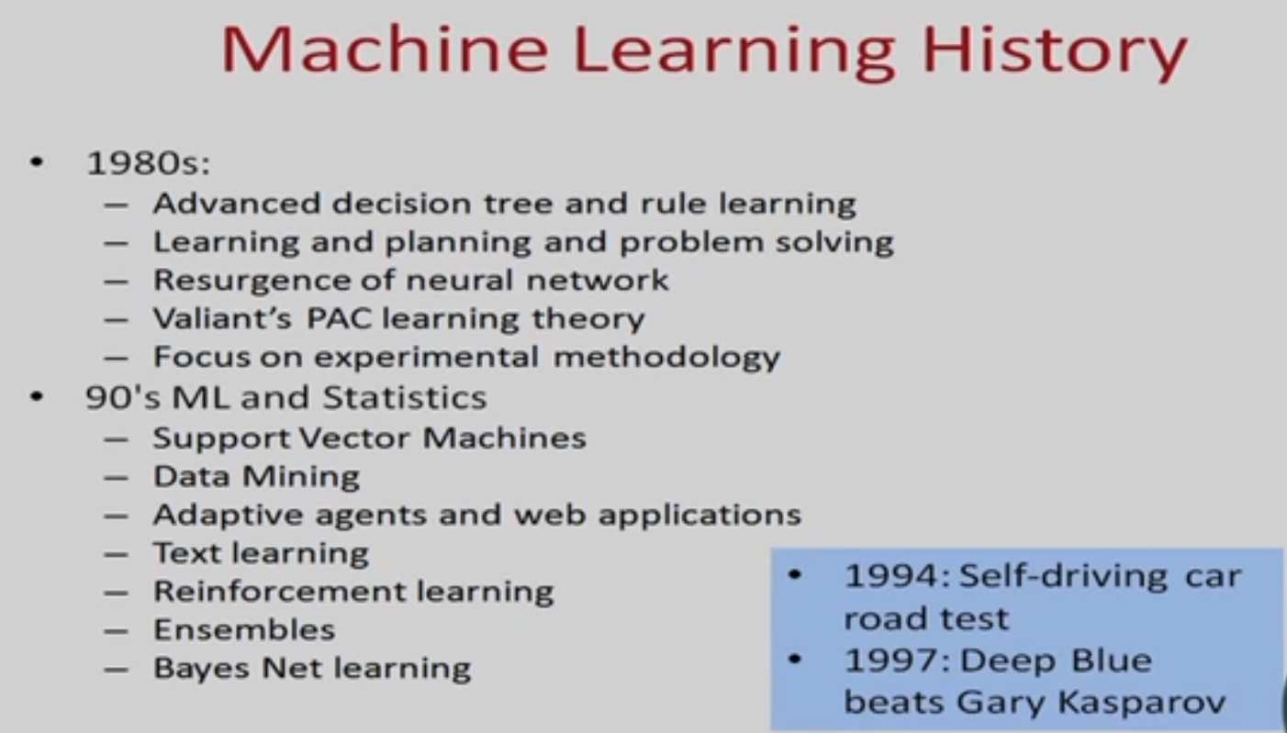

Slide 18
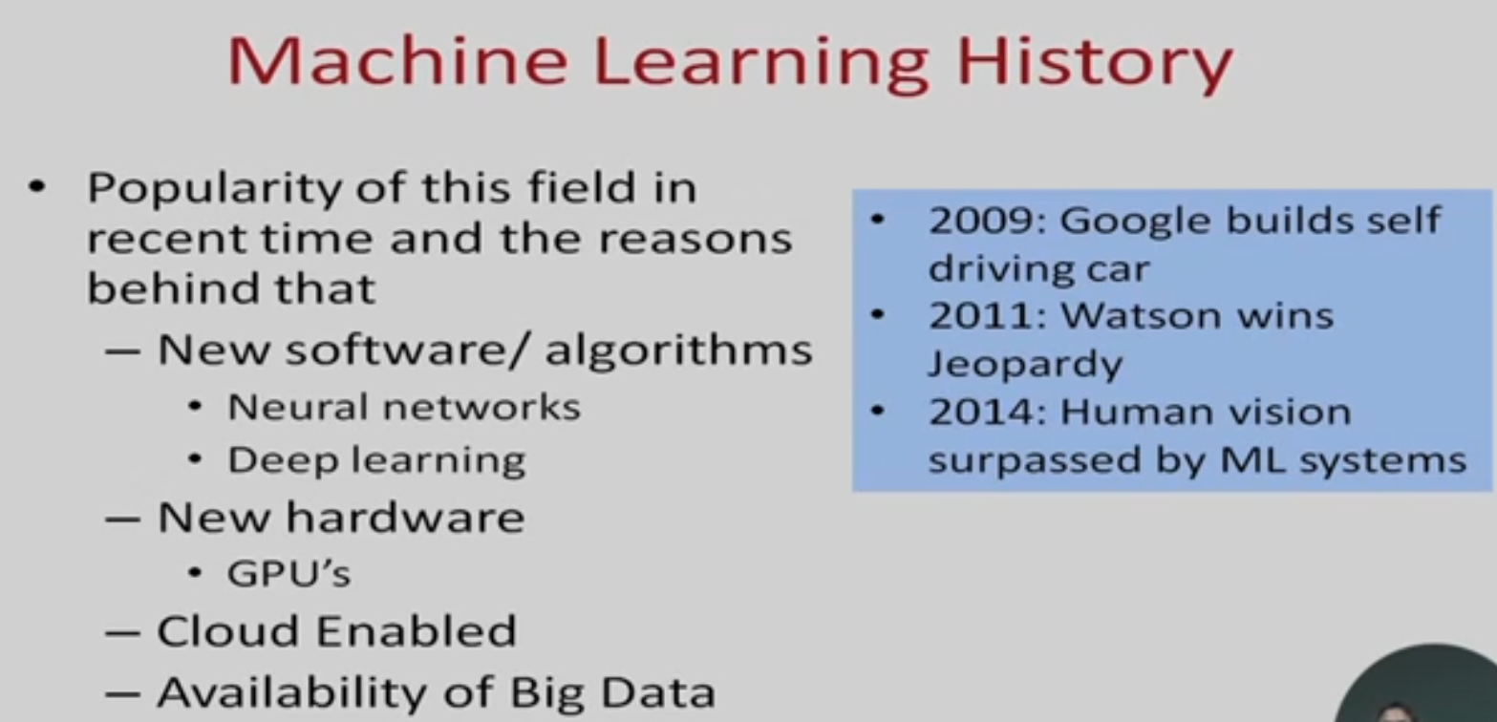

Slide 19
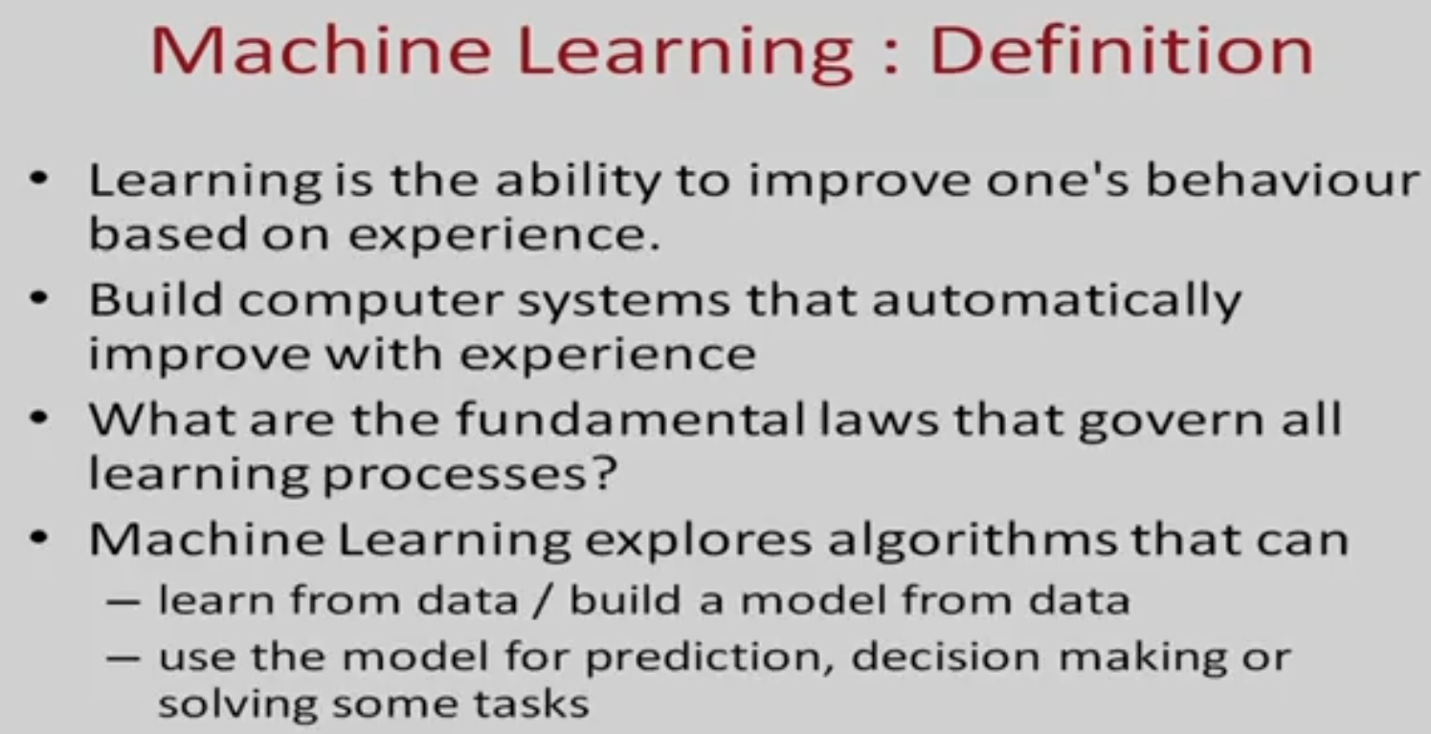

Slide 20
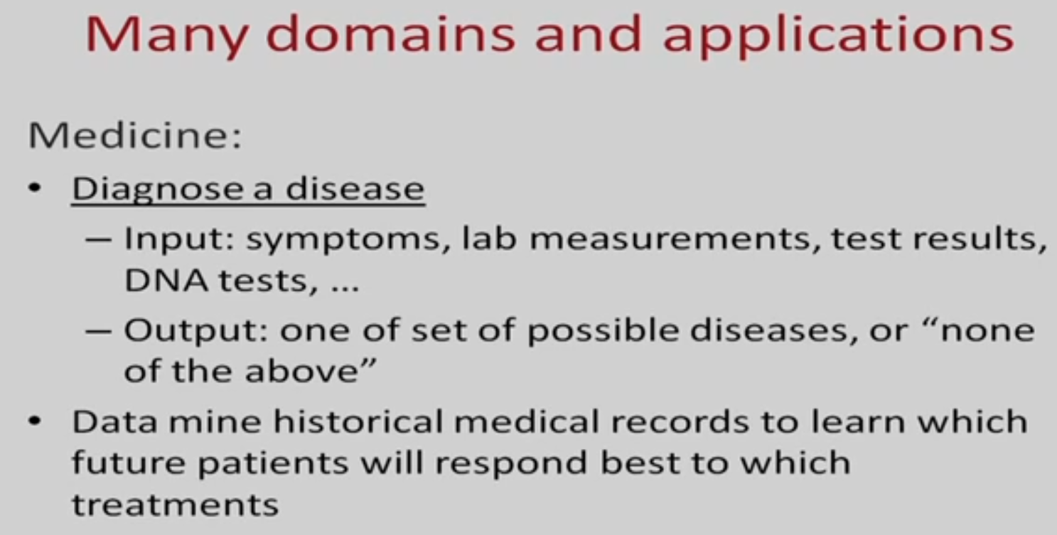

Slide 21
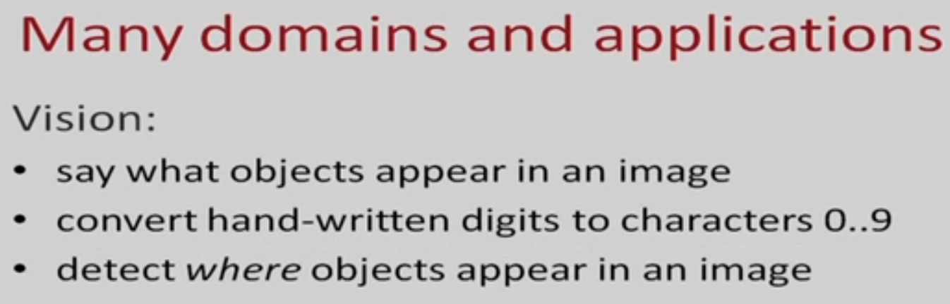

Slide 22
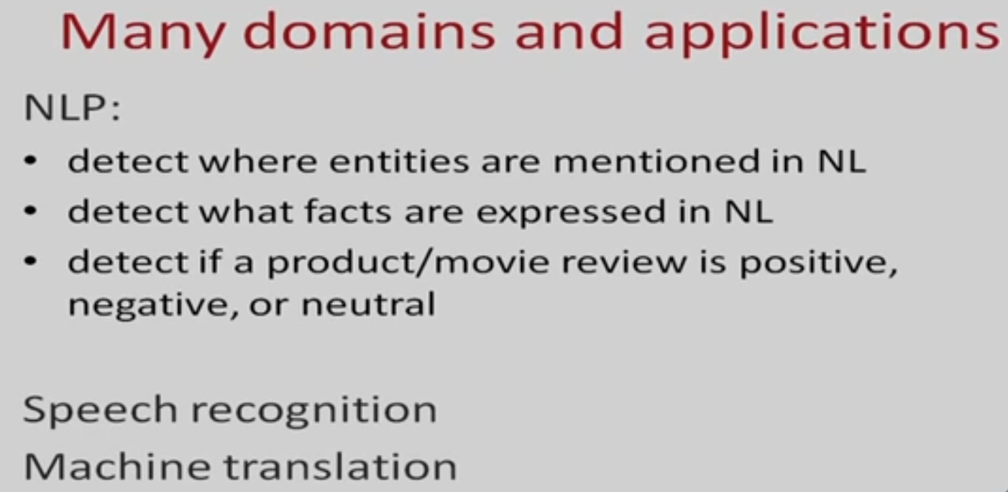

Slide 23
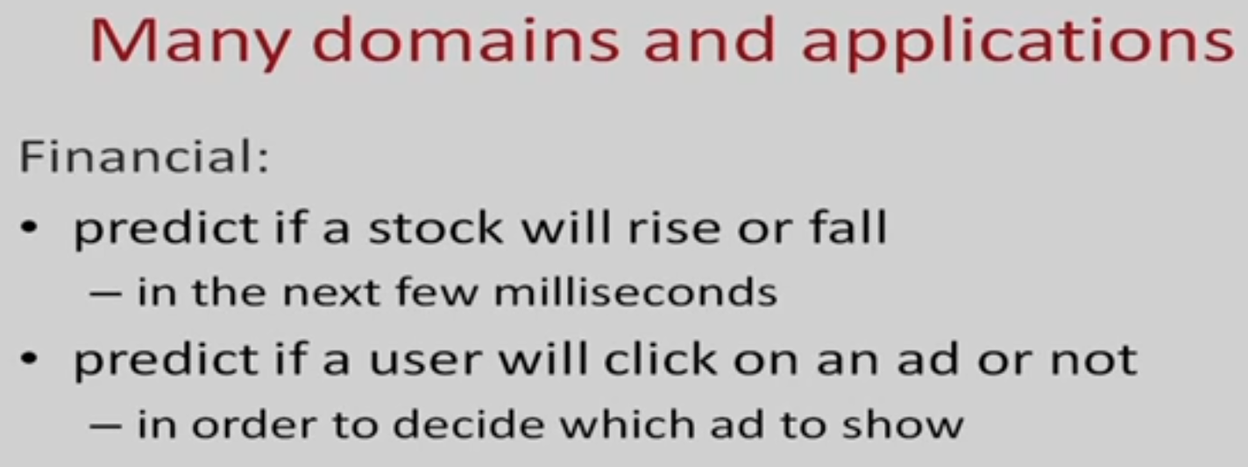

Slide 24
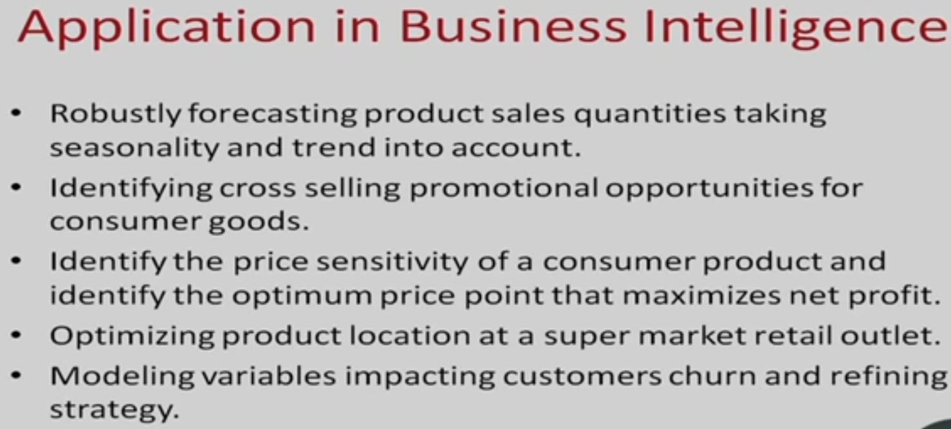

Slide 25
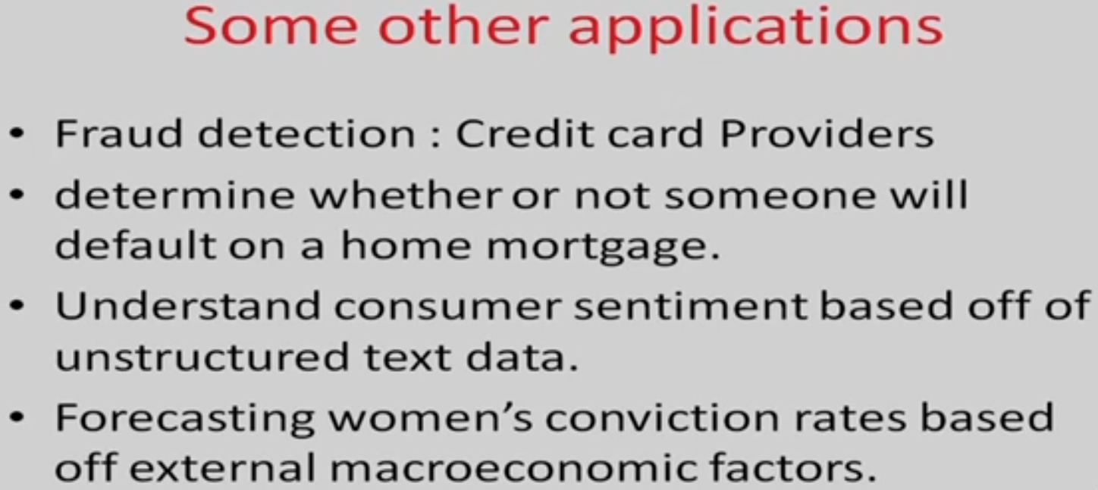

Slide 26
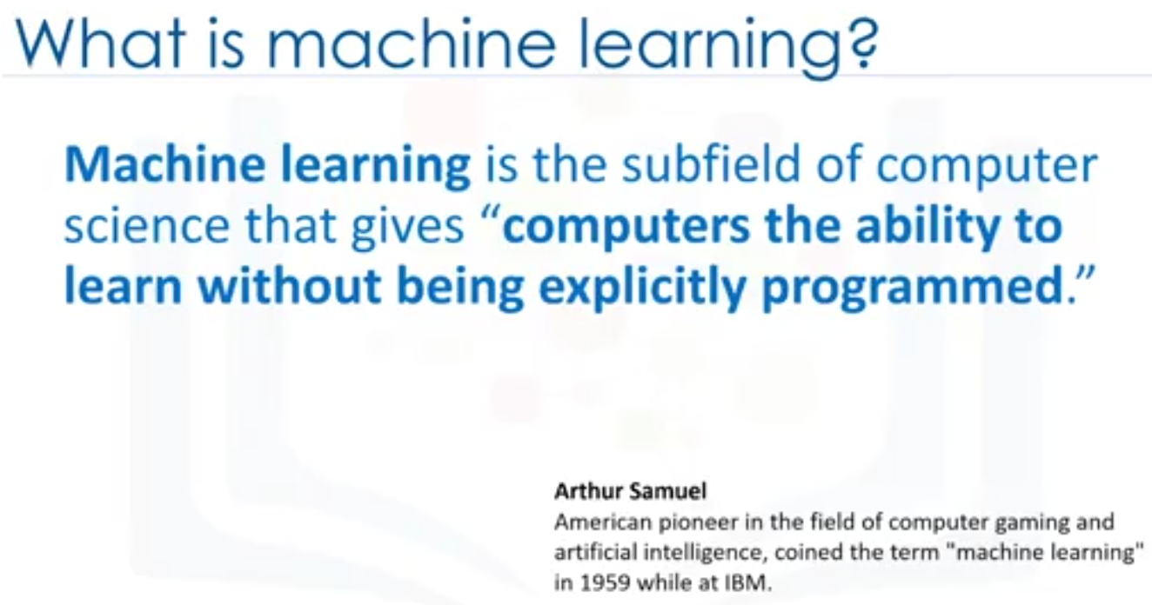
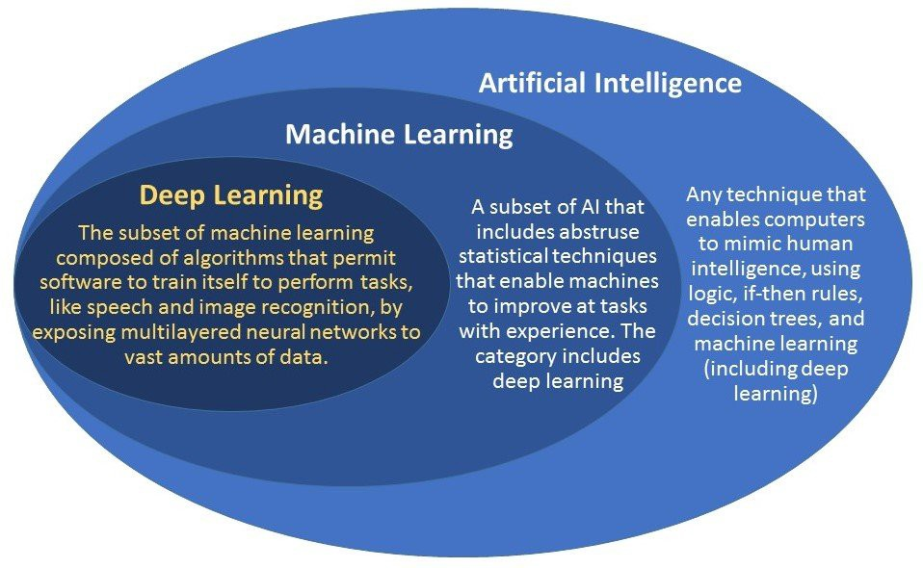

Slide 27
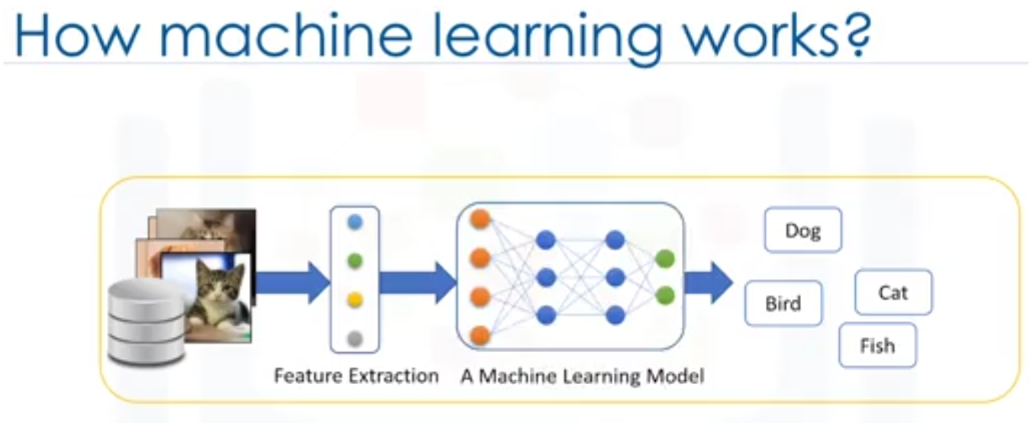
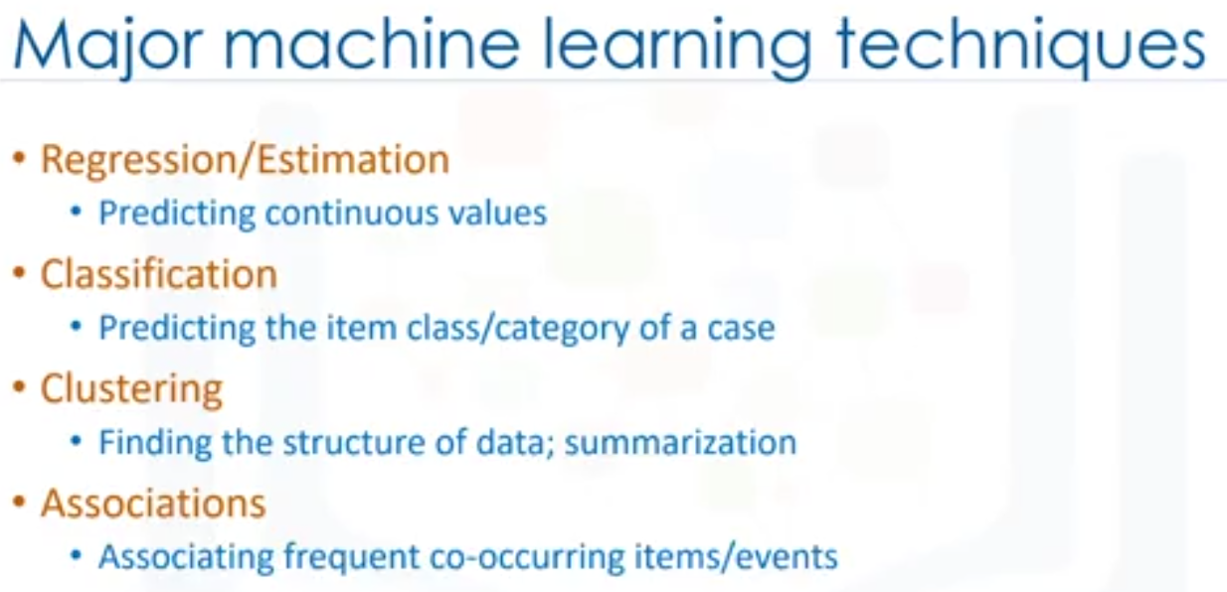

Slide 28
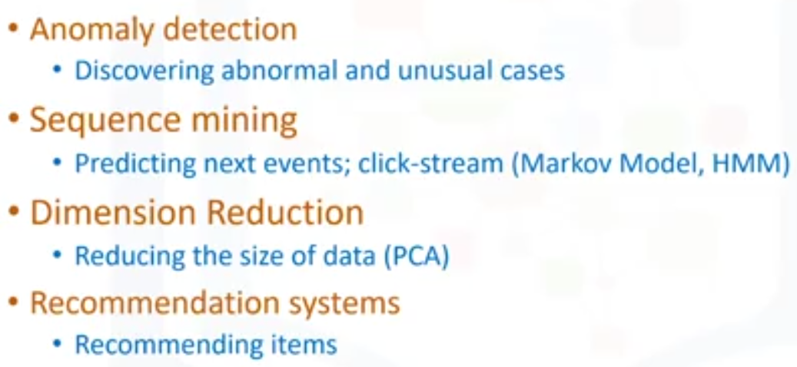
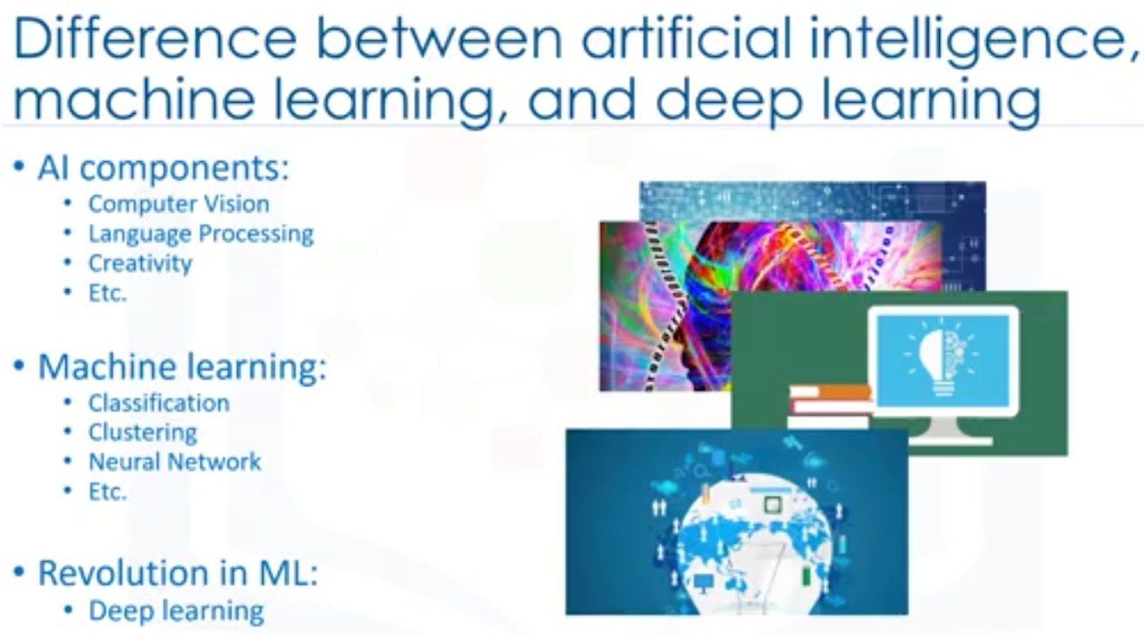

Slide 29
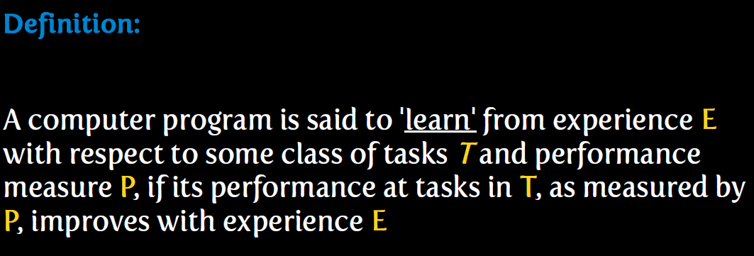

Slide 30
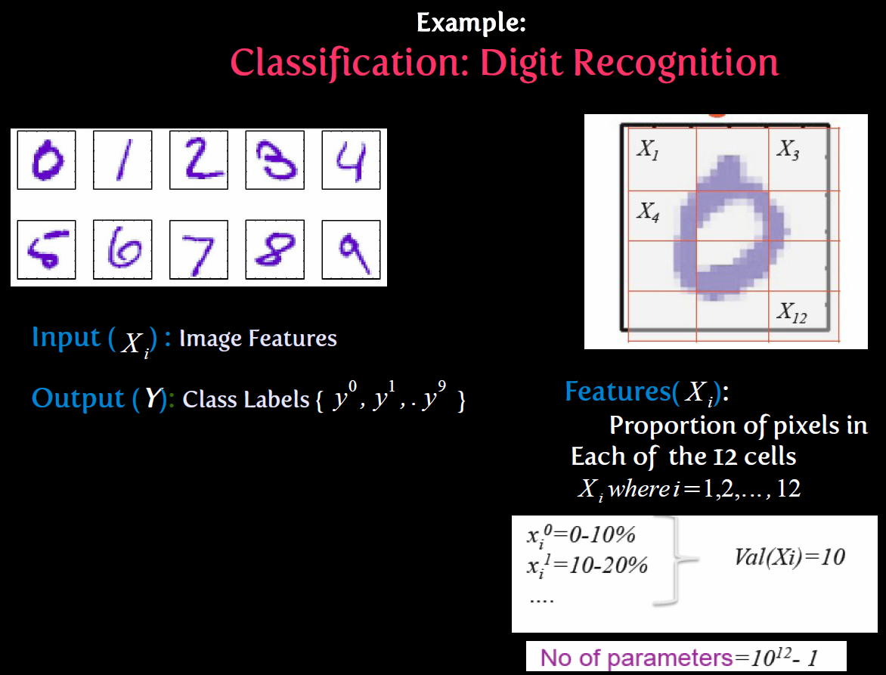

Slide 31
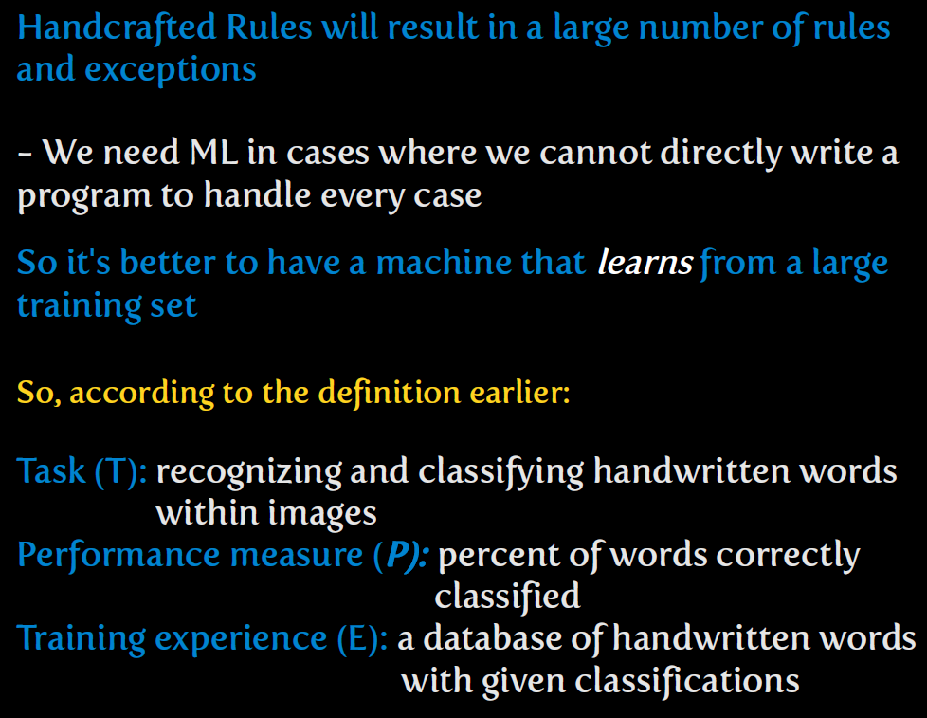

Slide 32

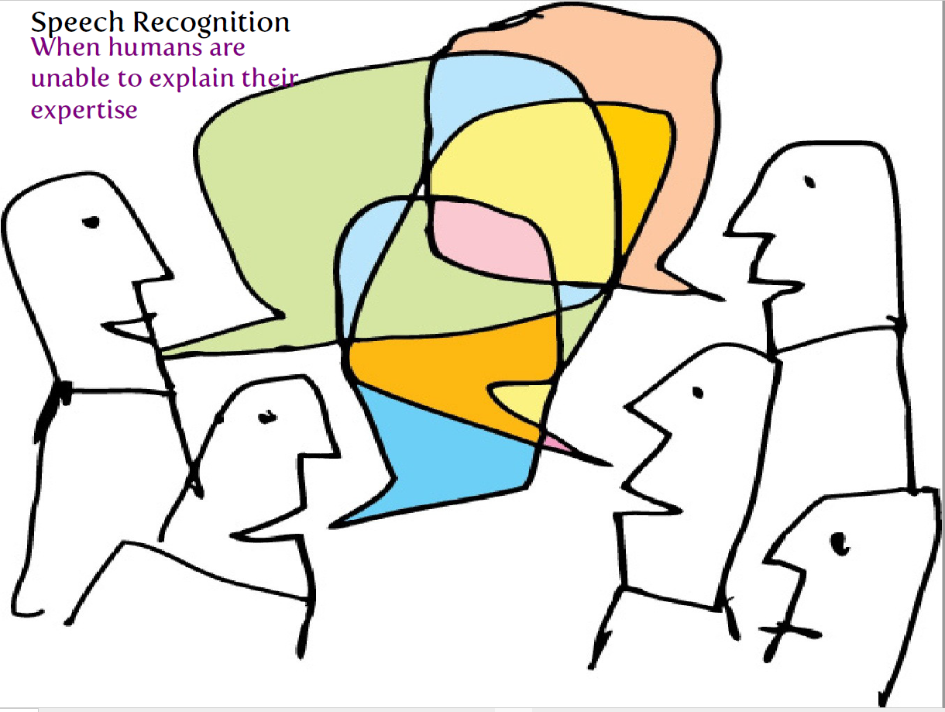

Slide 33


Slide 34
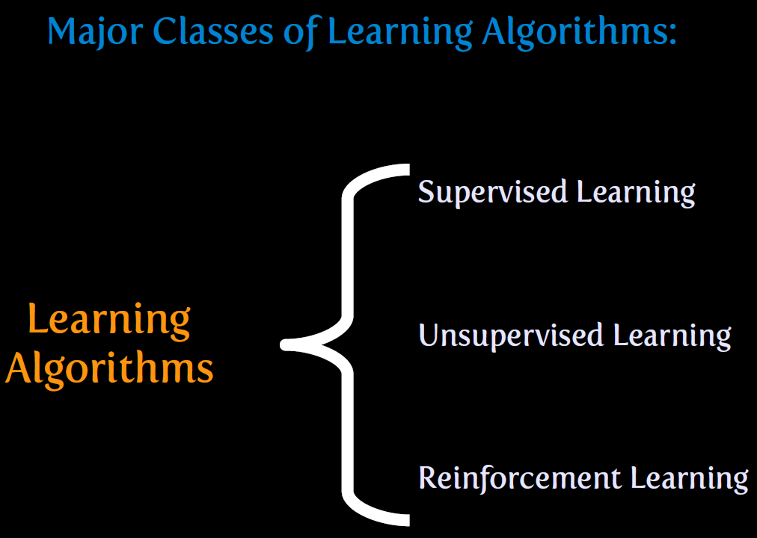

Slide 35
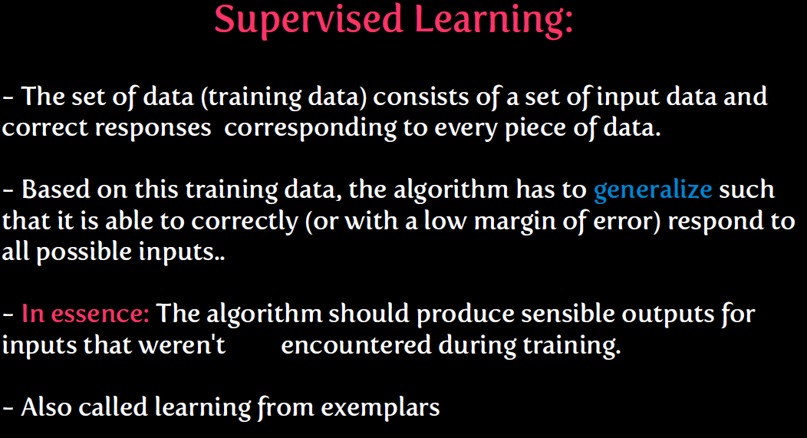

Slide 36
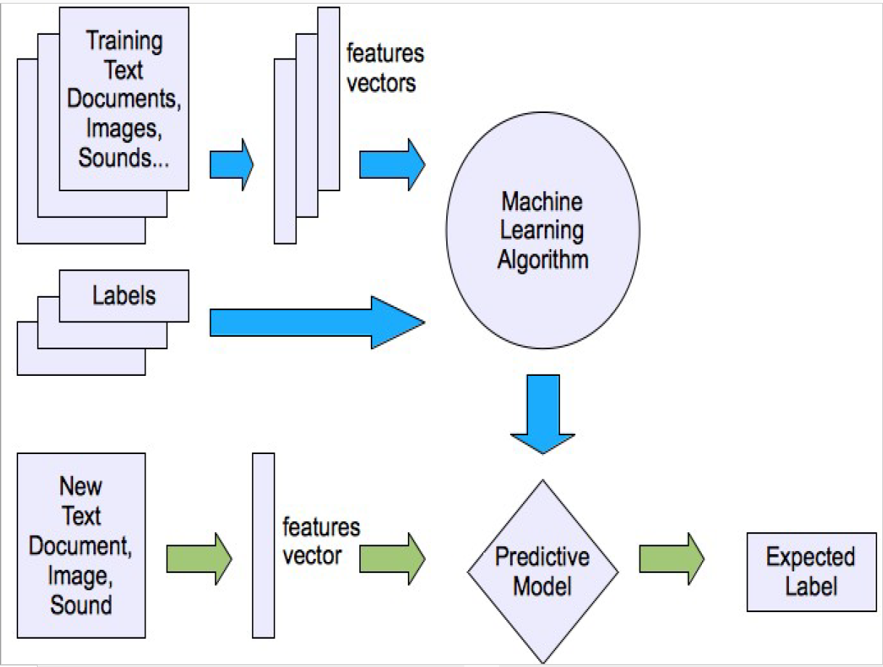

Slide 37
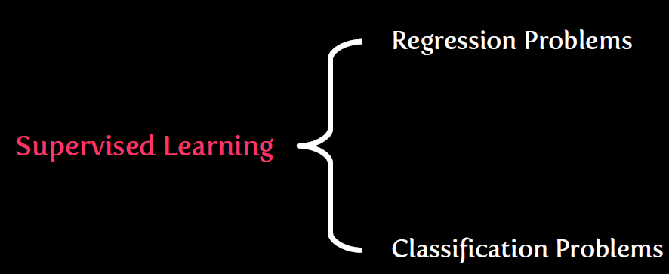

Slide 38
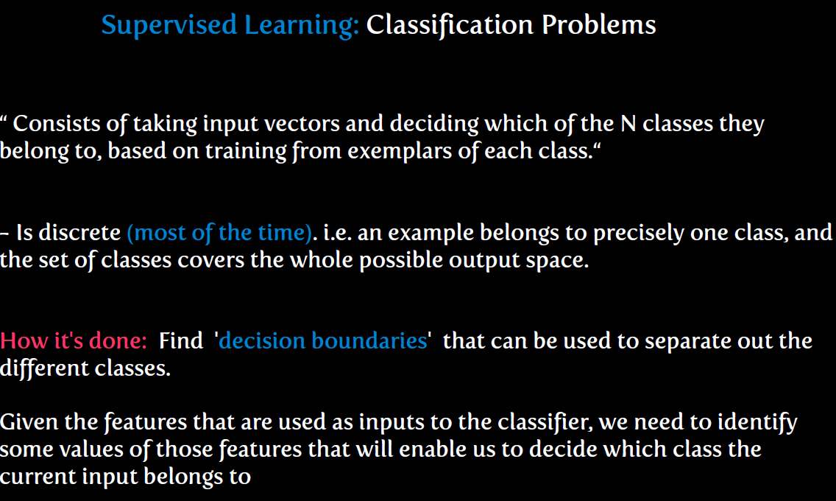

Slide 39
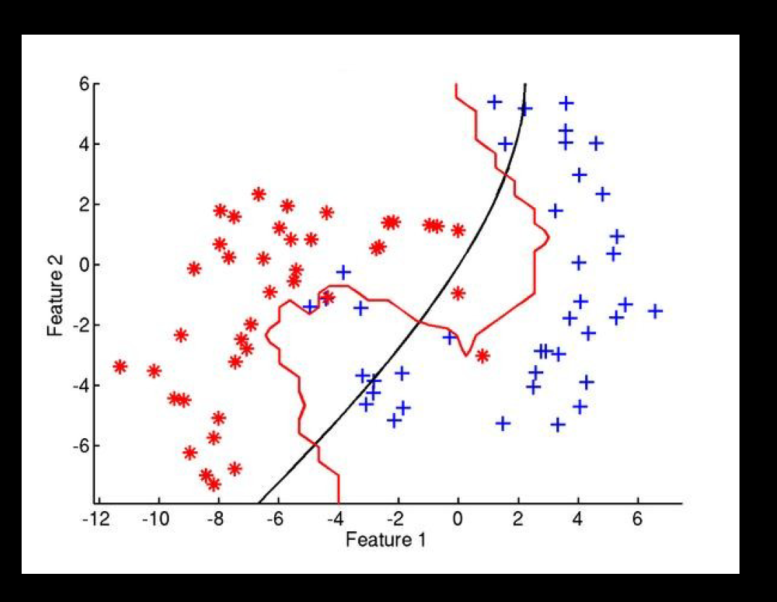

Slide 40
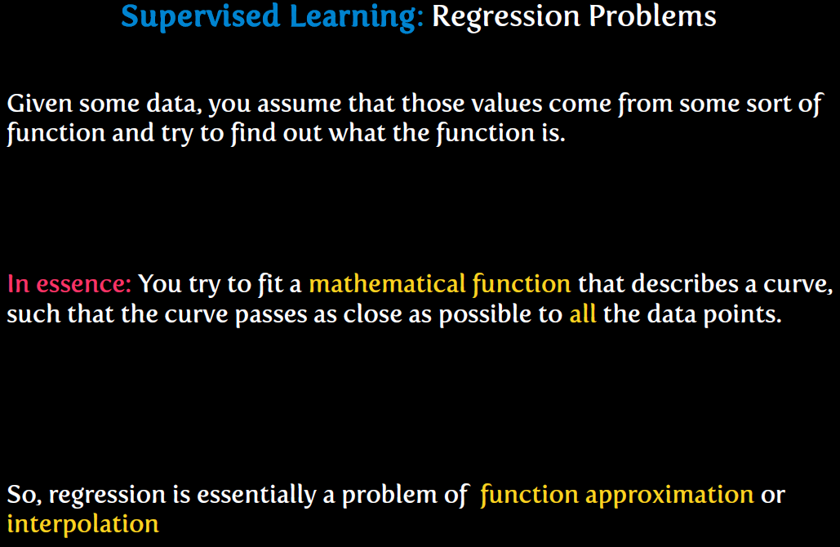

Slide 41
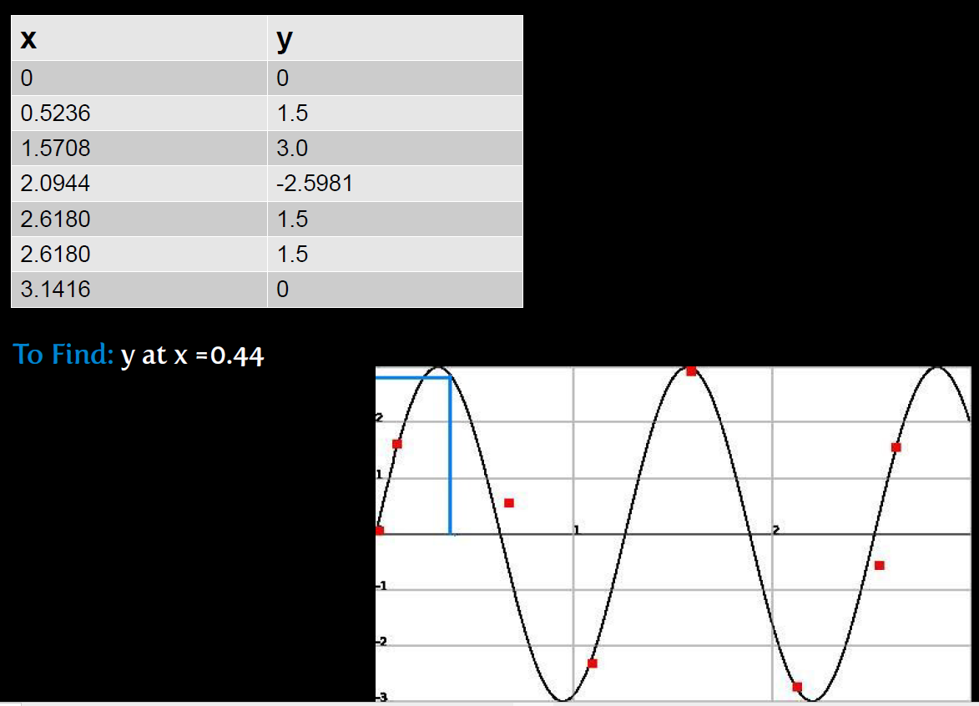

Slide 42
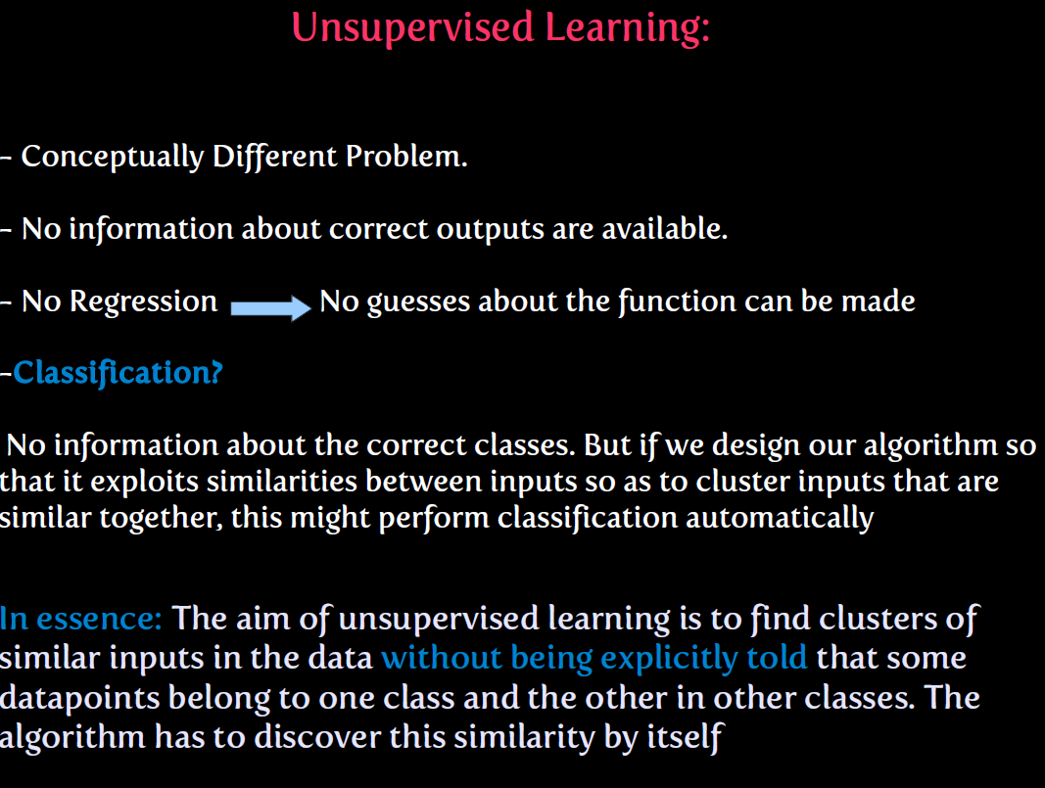

Slide 43
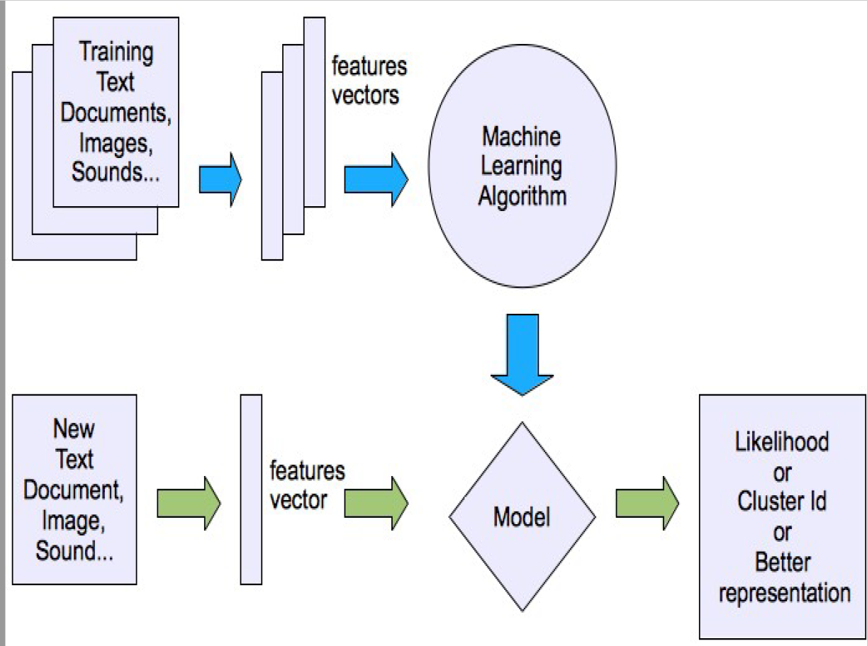

Slide 44
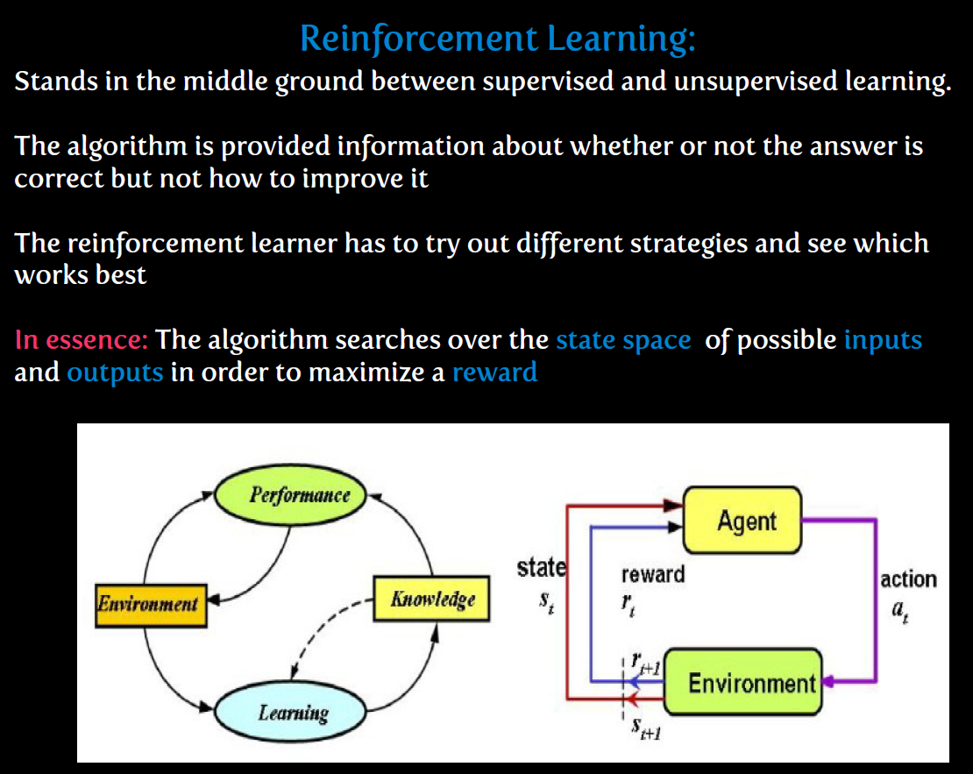

Slide 45


Slide 46
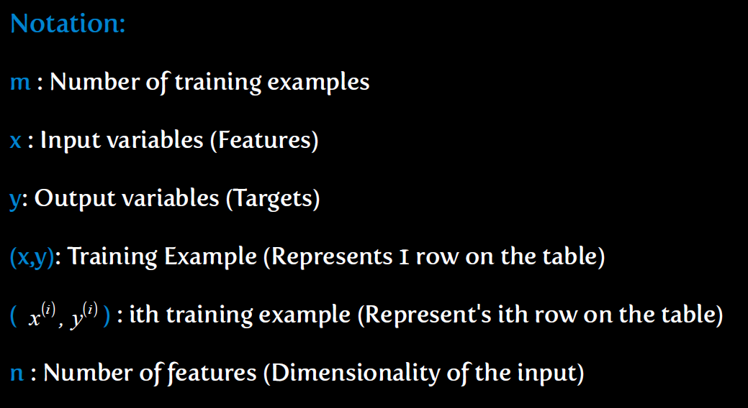

Slide 47
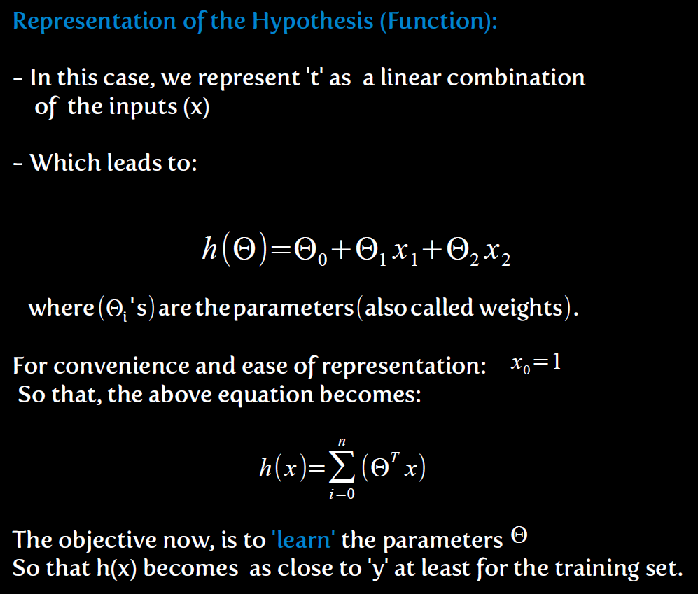

Slide 48
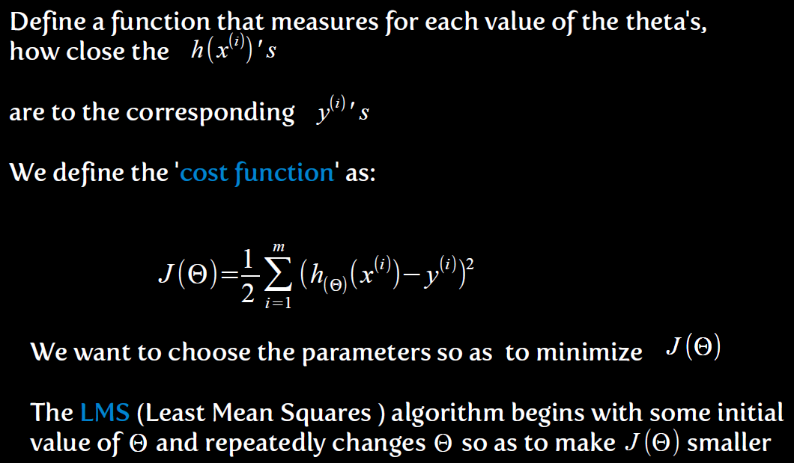

Slide 49
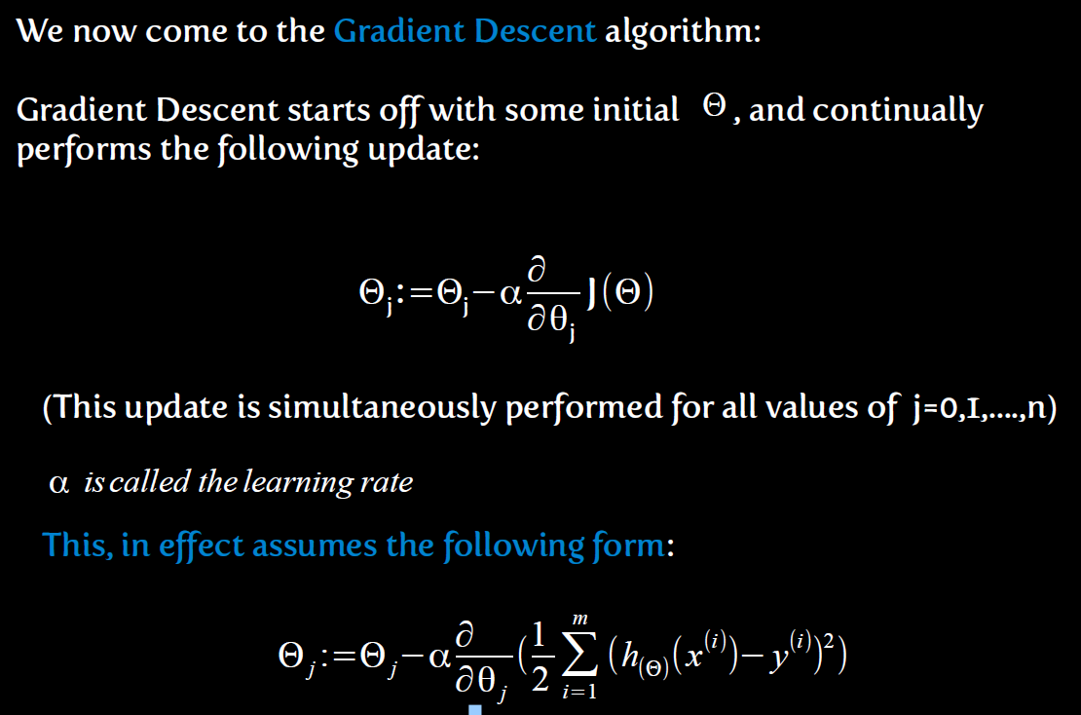

Slide 50
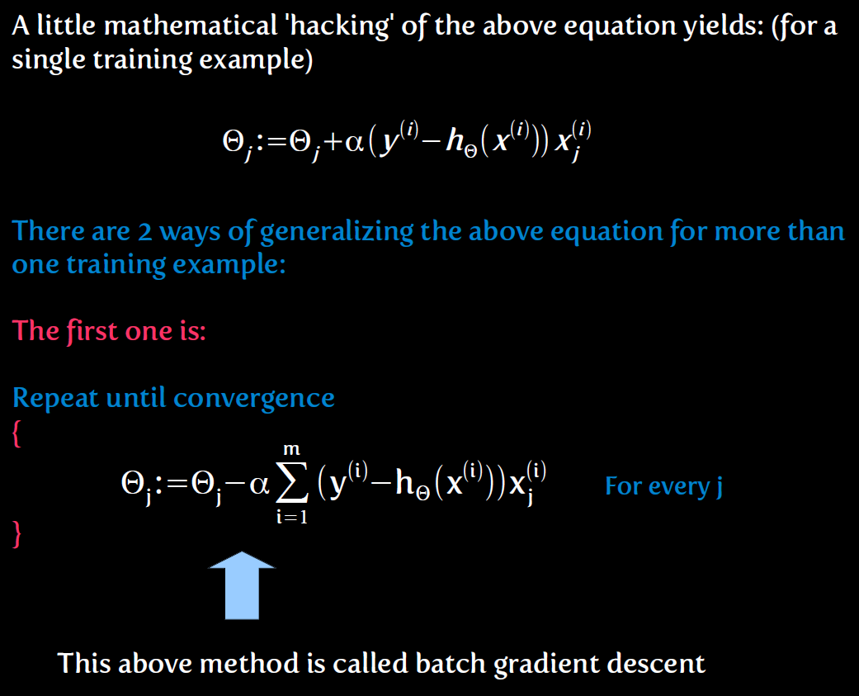

Slide 51
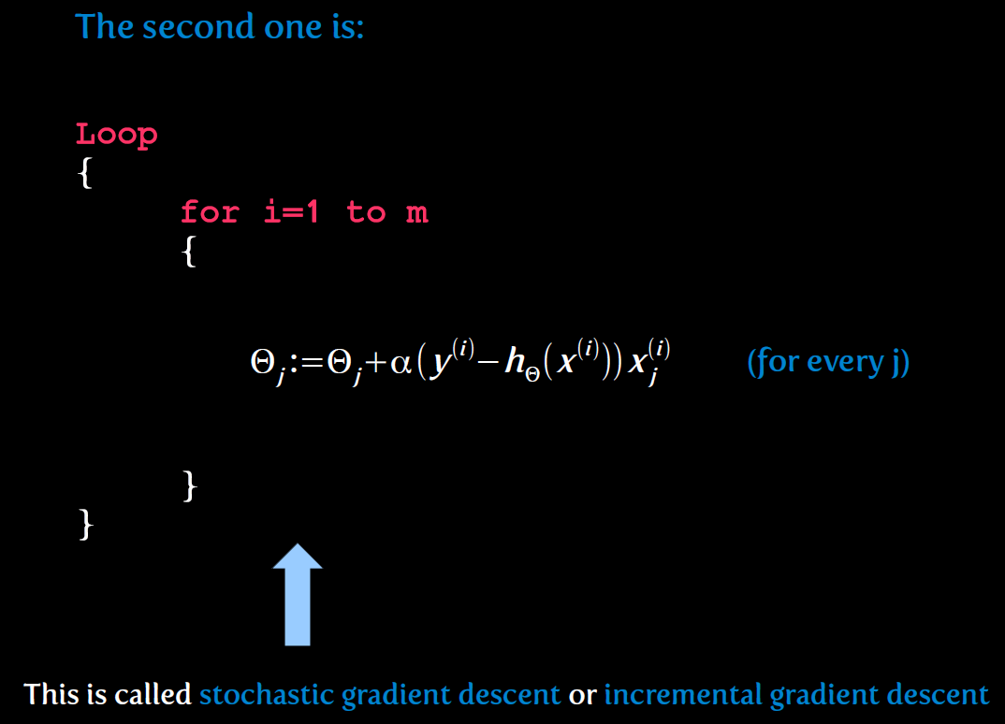

Slide 52
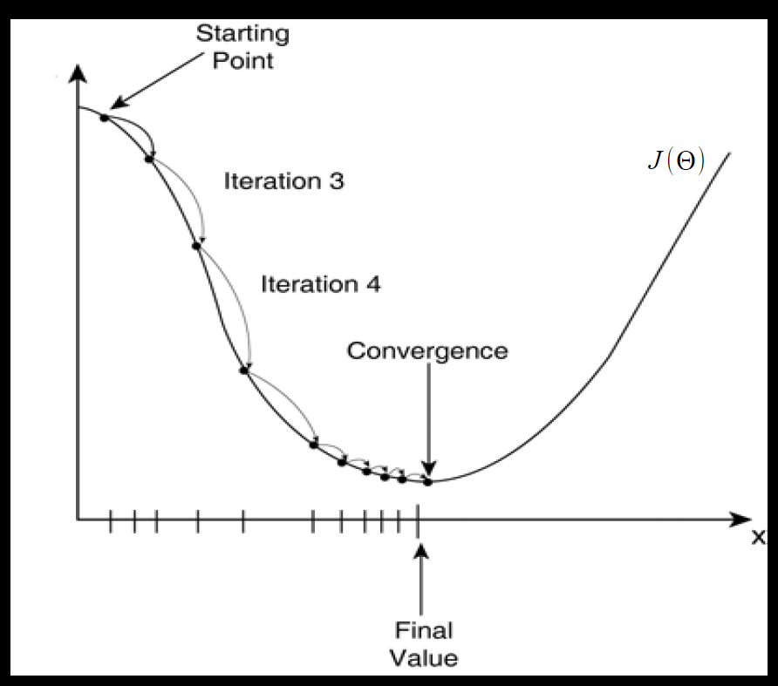

Slide 53
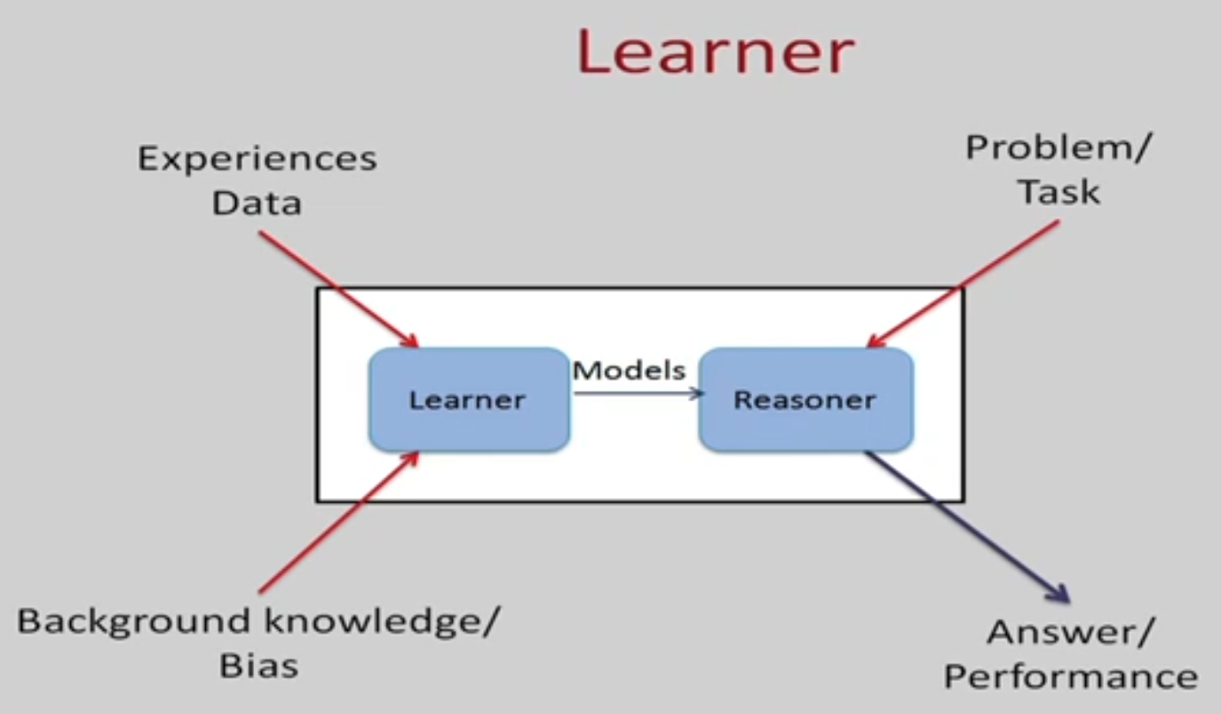

Slide 54
Programmatic Vs. Machine Learning Solution
Data Program
Output
Data Output
Program or Learning
to solve subsequent tasks
COMPUTER
COMPUTER

Slide 55
Formal Definition of Machine Learning
Arthur Samuel (1959).
Field of study that gives computers the ability to learn without being explicitly programmed.
Tom Mitchel (1998)
A computer program is said to learn
from experience E
with respect to some task T
and some performance measure P,
if its performance on T, as measured by P, improves with experience E.
Notes:
Suppose your email program watches which emails you do or do not mark as spam, and based on that learns how to better filter spam. What is the task T in this setting?
“

Slide 56
Definition of Machine Learning
Experiences/Data
Problem/Task
LEARNER
Models
REASONER
Background Knowledge/Bias
Answer/Performance
Notes:
We have to choose the training data. What is the target function or how to represent the model. Ex – given a board position what move to make.
Choose a learning algorithm that will infer the target function

Slide 57
Types of Learning
Supervised learning
predict y from x
Given a labelled set of input-output pairs, Map input x to output y
Given: Training set {(x_{i} , y_{i} ) | i = 1 … n}
Find: A good approximation to
f : X → Y
Classification – y is categorical
Regression – y is real values
Examples - spam detection, Digit Recognition, stock prices

Slide 58
Supervised Learning

Slide 59
Types of Learning
Unsupervised learning
model p(x), evaluate how likely x is, understand x
Find interesting patterns or knowledge discovery
clustering, patterns

Slide 60
Types of Learning
Reinforcement learning
Agent is acting in an environment.
Needs learn action to take at every step
Action depends on reward or punishment signals that the agent gets in each state
Notes:
Rlearner learns policy. Not only for short term reward but overall utility of agent over time horizon is optimized

Slide 61
Terminology
Feature Space represents the data in a set of n features
Features are properties that describe each instance in Instance space
Multiple features represented in a Feature Vector
We are given data and induction identifies a function, which can explain the data.
Hypothesis could be a function which is a line or curve which separates classes.
Hypothesis Space
is the set of all legal functions that are solutions to the task
Comprises of the features chosen and the language or the class of functions

Slide 62
Terminology

Slide 63
Hypothesis language - representations

Slide 64
Inductive Bias
Need to make assumptions
Experience alone does not allow us to make conclusions about unseen data instances
Examples
Occam’s Razor
prefer the simplest hypothesis.
Philosophical principle that if something can be described in a short language that hypothesis is to be preferred over a more complex hypothesis.
minimum description length
Maximum margin
Two types of Bias
Restriction :
Limit the Hypothesis space
For instance, Hypothesis language reflects the inductive bias of the learner
Preference
Impose ordering on Hypothesis Space

Slide 65
Inductive Learning
Inducing a general function from training examples.
Given some training examples, the objective is to generalize to test data
Construct hypothesis h to agree with c on the training examples.
Consistent Hypothesis agrees with all training examples.
hypothesis that is consistence with all the training examples
A hypothesis is said to generalize well if it correctly predicts the value of y for novel example.
Inductive Learning is an ill posed problem !
inductive learning hypothesis
A hypothesis which has a low training error over a sufficiently large training set is expected to do well on unseen examples.

